Slide 1
SEALED CLASSES & METHODS

Slide 2
CONTENTS:
Introduction To Inheritance
Introduction To Sealed Classes
Syntax of Sealed Class
Why Sealed Classes
Sealed Classes With Error & Without Error
Sealed Methods
Sealed Methods With Error & Without Error
Advantages of Sealed Classes & Methods

Slide 3
INHERITANCE
Inheritance is an important pillar of OOP(Object Oriented Programming). It is the mechanism in C# by which one class is allowed to inherit the features(fields and methods) of another class.
Important terminology:
Super Class: The class whose features are inherited is known as super class(or a base class or a parent class).
Sub Class: The class that inherits the other class is known as subclass(or a derived class, extended class, or child class). The subclass can add its own fields and methods in addition to the superclass fields and methods.
Reusability: Inheritance supports the concept of “reusability”,

Slide 4
SEALED CLASSES
Sealed classes are used to restrict the users from inheriting the class.
A class can be sealed by using the sealed keyword. The keyword tells the compiler that the class is sealed, and therefore, cannot be extended.
No class can be derived from a sealed class.

Slide 5
SYNTAX OF SEALED CLASS
The following is the syntax of a sealed class :
sealed class class_name
{
// data members
// methods
.
.
.
}

Slide 6
WHY SEALED CLASSES
Sealed class is used to stop a class to be inherited. You cannot derive or extend any class from it.
Sealed method is implemented so that no other class can overthrow it and implement its own method.
The main purpose of the sealed class is to withdraw the inheritance attribute from the user so that they can’t attain a class from a sealed class. Sealed classes are used best when you have a class with static members.

Slide 7
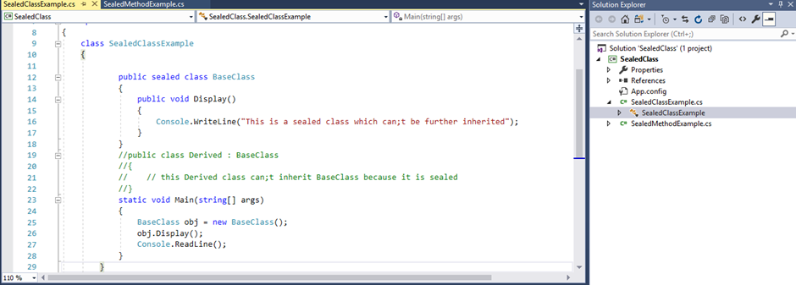
Sealed Class Without Error :

Slide 8
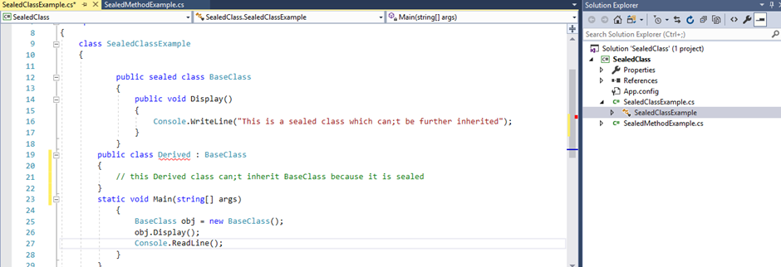

Sealed Class With Error :
ERROR DISPLAY :

Slide 9
SEALED METHODS
Sealed method is used to define the overriding level of a virtual method.
Sealed keyword is always used with override keyword.

Slide 10
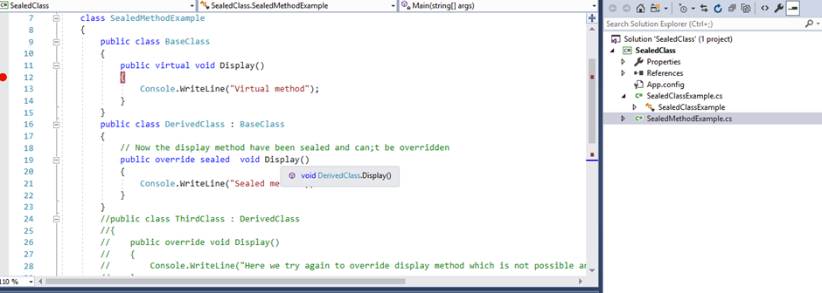
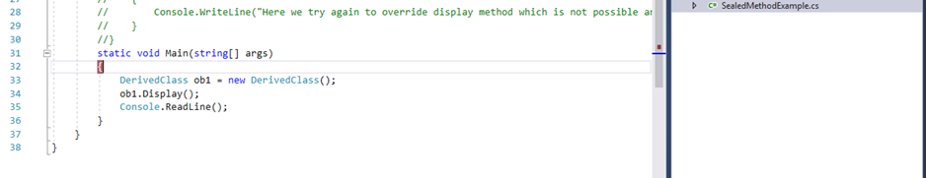
Sealed Methods Without Error :

Slide 11
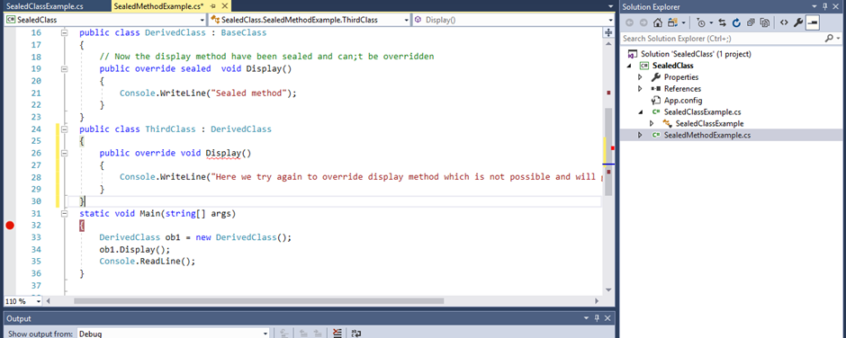
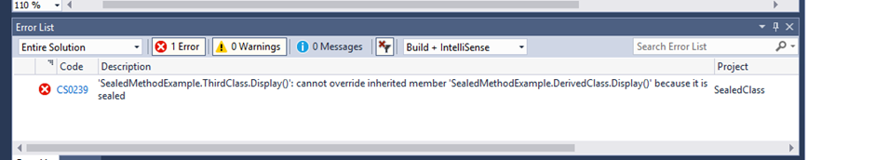
Sealed Methods With Error :
ERROR DISPLAY :

Slide 12
Advantages of Sealed Classes & Methods
Sealed keyword in C# applies restrictions on the class and method
At class level sealed modifier prevents a class from being inherited.

